Slide 1
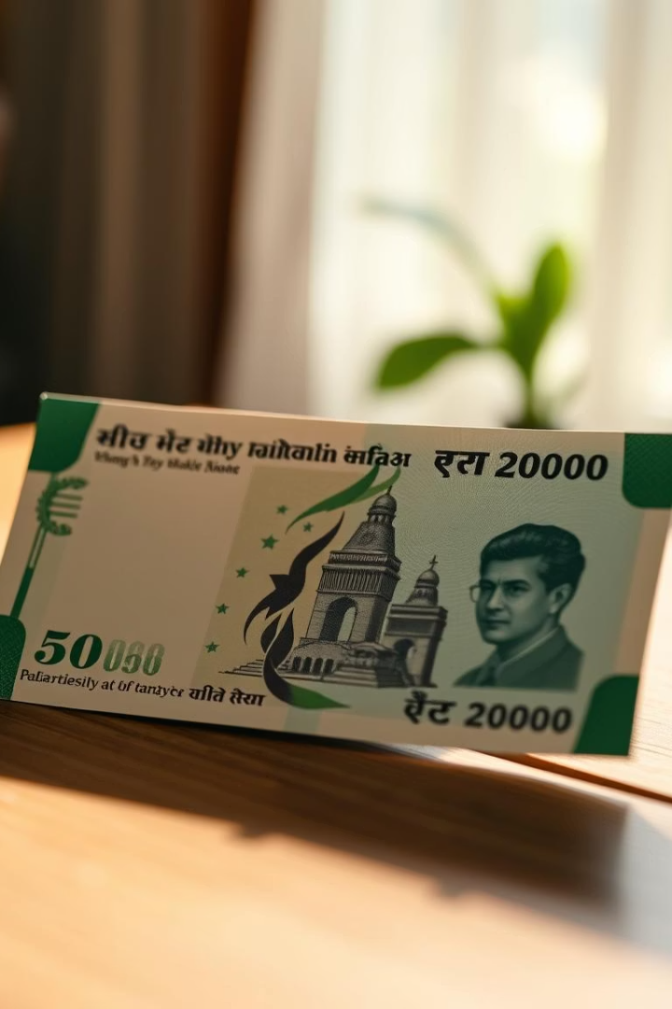
Fake Indian Currency Note Detection using Image Processing
This presentation delves into an AI-driven approach to detect counterfeit Indian currency, focused on ₹500 and ₹2000 notes. Employing advanced image processing techniques and computer vision algorithms, the project aims to equip users outside formal banking environments with a reliable tool to distinguish fake notes swiftly and accurately. Using Python and OpenCV, it leverages both classical feature extraction and image comparison methods to address this critical security challenge.

Slide 2

Project Objectives & Technological Framework
Core Objectives
Automate counterfeit note detection
High accuracy with fast processing time
User-friendly interface for accessibility
Technologies & Tools
Python programming language
OpenCV for image processing
ORB Detector for feature extraction
SSIM, Gaussian Blur, thresholding techniques
Implementations inside jupyter Notebook environment

Slide 3

Literature Review and Comparative Analysis
Author
Approach
Key Points
Limitations
Darade [1]
Feature Extraction
Low cost
Needs external camera
Yadav & Patil [2]
HSV + MATLAB
Efficient detection
Requires full setup
Zarin & Uddin [3]
OCR
93.3% accuracy
Complex implementation
Veling [4]
Hyperspectral Imaging
Dual method effectiveness
High cost
Mangayarkarasi et al. [5]
Feature extraction + voice
Good for visually impaired
Fails on damaged notes

Slide 4
Key Security Features for Note Authentication
Visual Features
Additional Markers
Bleed Lines (5 on ₹500, 7 on ₹2000)
Number Panel with 9-digit serial number
Security Thread with color shift
RBI Seal and Ashoka Pillar emblem
Watermark (Gandhi + numeral)
Denominational script in English & Devanagari
Latent Image (denomination at angle)

Slide 5





Methodology and Algorithmic Approach
Dataset Creation
Collect real and fake ₹500 & ₹2000 note images under varying illumination and perspectives for robust training.
Algorithm 1: Feature Detection
Use ORB detector with Gaussian Blur and grayscale preprocessing; compare features via SSIM score for similarity assessment.
Algorithm 2: Bleed Line Detection
Apply thresholding and contour analysis to count bleed lines accurately as a signature feature.
Algorithm 3: Number Panel Recognition
Thresholding followed by character count verification ensures authenticity of serial numbers.

Slide 6

System Workflow for Real-Time Detection
Final Decision
Feature Detection & Matching
Integrate bleed line count and number panel checks; classify note as real or fake through combined score analysis.
Preprocessing
Image Acquisition
Standardize image size, apply Gaussian Blur to reduce noise, and convert to grayscale for processing.
Execute ORB-based feature extraction, match with templates, and compute SSIM for similarity scoring.
Capture high-quality images of notes using a standard camera or smartphone under controlled lighting.

Slide 7




Evaluation & Results
High Accuracy
Consistent identification of counterfeit notes across multiple lighting conditions and note orientations.
Fast Processing
Real-time or near real-time validation without reliance on specialized hardware.
Public Accessibility
Designed for ease of use by common people outside banking sectors via an intuitive interface.

Slide 8

Conclusions and Future Directions
Project Impact
Potential Improvements
The project provides a scalable, low-cost counterfeit detection solution enabling safer cash transactions.
Integration of OCR for serial number recognition, deep learning classifiers, and mobile app deployment for broader adoption.
Next Steps
Expanding dataset diversity, user testing, and integration with banking and retail sectors for live validation.

Slide 9

contributors:
Advik Tushir - E22CSEU1292
Ryaan Ajmal - E22CSEU1310

